Slide 1
Development of Optimal Ligament Wrapping Algorithm
Michael Vignos
ME 748
May 9th, 2016

Slide 2
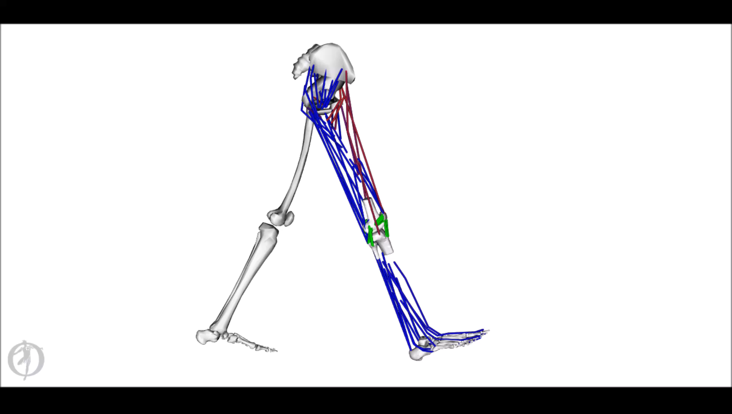
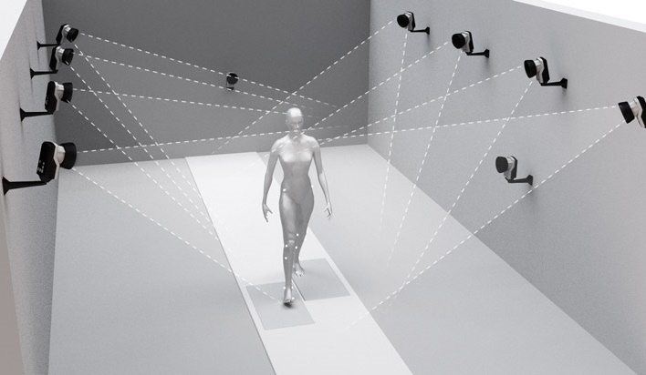
Musculoskeletal Multi-Body Modeling
Motion Capture Data
Muscle Forces
Ligament Forces
Cartilage Pressure

Slide 3
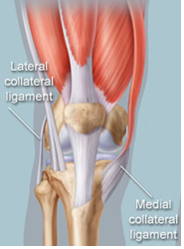
Ligaments
Human knee ligaments
Ligaments in musculoskeletal model

Slide 4
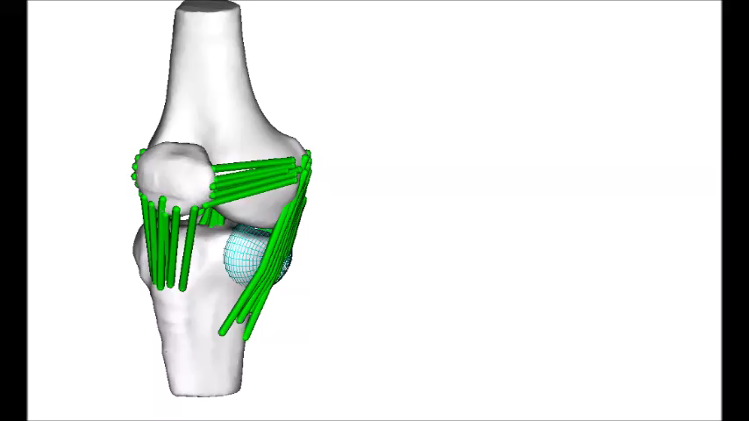
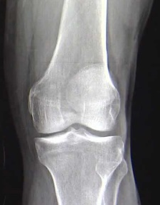
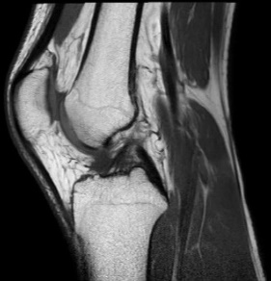
Shortcomings of Wrap Objects
Wrap Object Limitations
Rapid Model Generation
Placing wrap objects in these models is infeasible
Non-physiological approximation
Time consuming to place
Can sometimes give poor results

Slide 5
Objective
To develop an efficient optimization routine to compute the wrapping of a ligament around two bones

Slide 6
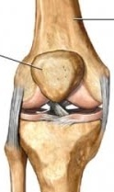
Optimization Problem
Objective:
Minimize the ligament length
Optimization Parameters:
Three-dimensional location of nodes on the ligament path
Constraint:
Nodes must lie on the surface of the bones
Additional Requirements:
Optimization needs to be fast
Ligament path needs to be smooth
Femur Attachment Point
(x_{i}, y_{i}, z_{i})
Tibia Attachment Point

Slide 7
Optimization Approaches
Four optimization approaches
Two unconstrained
Two constrained
Optimization speed improved by providing analytical solution of gradient for objective function and constraints

Slide 8
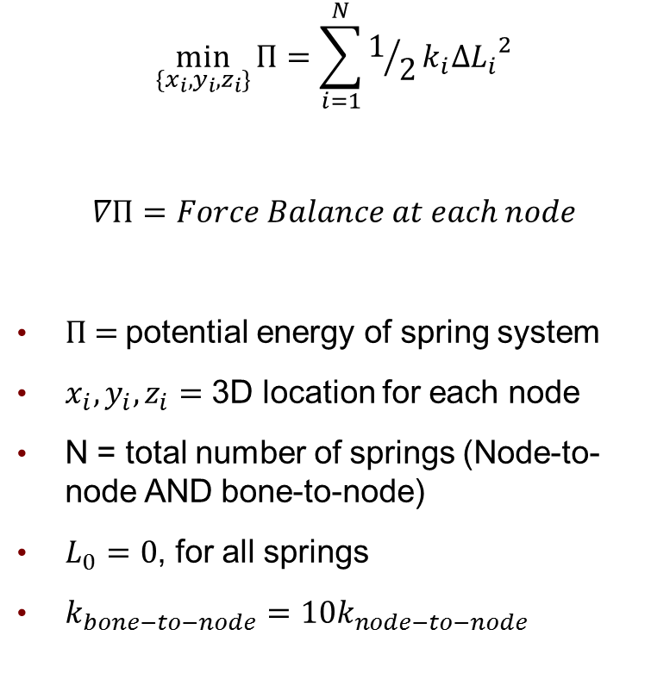
Method 1
fminunc
$$\min_{\{x_{i},y_{i},z_{i}\}}{Π=\sum_{i=1}^{N}{1/2k_{i}∆{L_{i}}^{2}}}$$
$$∇Π=Force Balance at each node$$
П = potential energy of spring system
$x_{i},y_{i},z_{i}=$ 3D location for each node
N = total number of springs (Node-to-node AND bone-to-node)
$L_{0}=0$, for all springs
$k_{bone−to−node}=10k_{node−to−node}$
Femur
= spring
= free node
= fixed node
Tibia

Slide 9
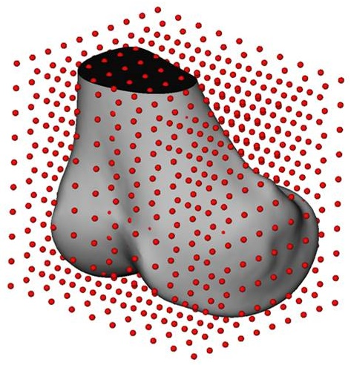
Signed Distance Field
Compute signed distance between a point and a closed surface
+ distance = outside surface
- distance = inside surface
Tri-cubic interpolation to compute distance between field points
Significantly faster than searching for nearest point
Code provided by: G. Elisabeta Marai, Department of Computer Science, Brown University

Slide 10
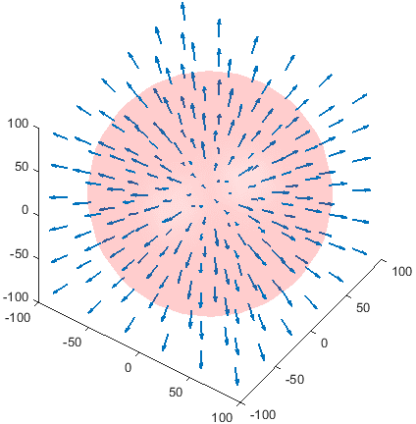
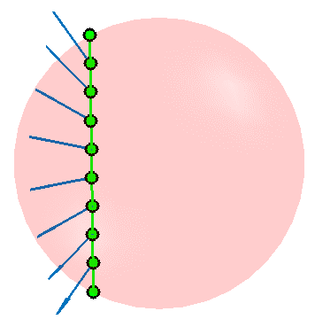
Gradient of Signed Distance Field
Used central finite difference to compute gradient at each field point
Tri-cubic interpolation to compute gradient for points that fall between field points

Slide 11
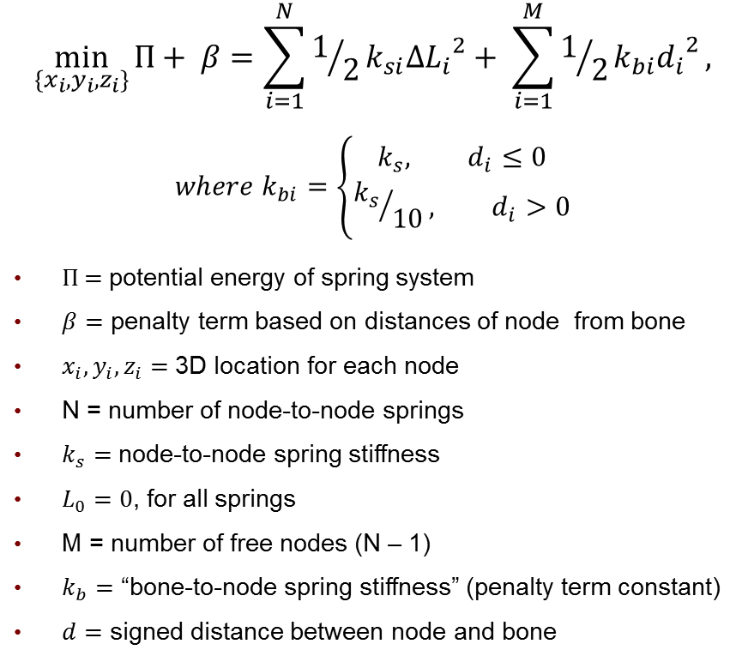
Method 2
Advantage over method 1: Does not require all nodes to stay “attached” to bones
fminunc
Femur
$$\min_{\{x_{i},y_{i},z_{i}\}}{Π+ β=\sum_{i=1}^{N}{1/2k_{si}∆{L_{i}}^{2}}}+ \sum_{i=1}^{M}{1/2k_{bi}{d_{i}}^{2}},$$
$$where k_{bi}=\left\{\begin{matrix}k_{s}, d_{i}≤0 \\ {k_{s}}/{10}, d_{i}>0\end{matrix}\right.$$
П = potential energy of spring system
$β=$ penalty term based on distances of node from bone
$x_{i},y_{i},z_{i}=$ 3D location for each node
N = number of node-to-node springs
$k_{s}=$ node-to-node spring stiffness
$L_{0}=0$, for all springs
M = number of free nodes (N – 1)
$k_{b}=$ “bone-to-node spring stiffness” (penalty term constant)
$d=$ signed distance between node and bone
= spring
= free node
= fixed node
= distance between node and bone
d₁
d₂
Tibia
d₃
d₄
d₅

Slide 12
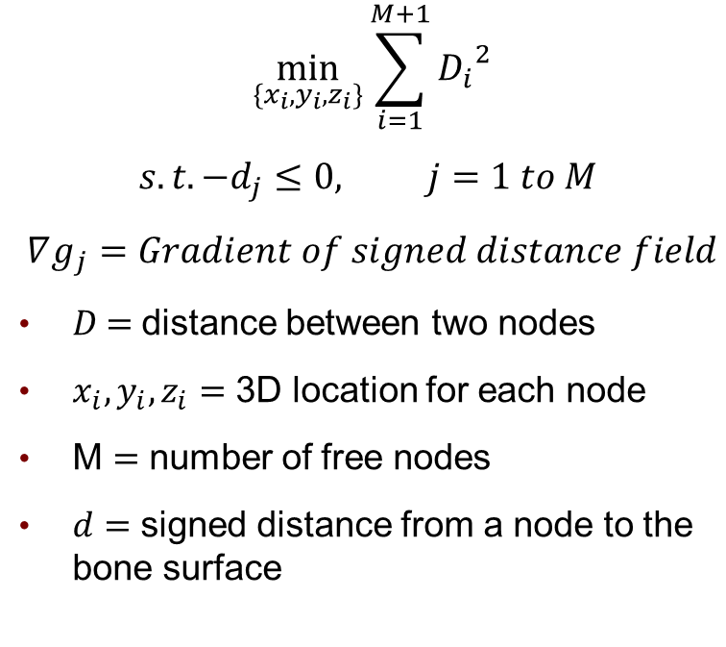
Method 3
Advantage over method 2: Converges to a “good” solution faster due to analytical solution for gradient of constraints
Femur
fmincon
$$\min_{\{x_{i},y_{i},z_{i}\}}{\sum_{i=1}^{M+1}{{D_{i}}^{2}}}$$
$$s.t. −d_{j}≤0, j=1 to M$$
$$∇g_{j}=Gradient of signed distance field$$
$D$ = distance between two nodes
$x_{i},y_{i},z_{i}=$ 3D location for each node
M $=$ number of free nodes
$d=$ signed distance from a node to the bone surface
D₁
= free node
= fixed node
d₁
Tibia
D₆
d₅

Slide 13
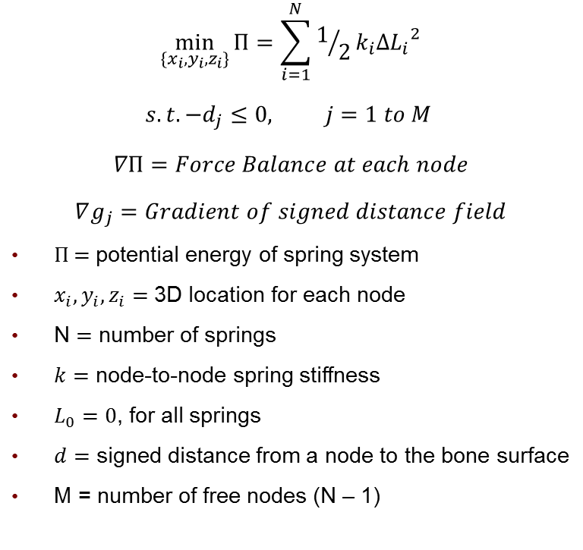
Method 4
Advantage over method 3: Analytical solution for gradient of objective function and constraints
fmincon
Femur
$$\min_{\{x_{i},y_{i},z_{i}\}}{Π=\sum_{i=1}^{N}{1/2k_{i}∆{L_{i}}^{2}}}$$
$$s.t. −d_{j}≤0, j=1 to M$$
$$∇Π=Force Balance at each node$$
$$∇g_{j}=Gradient of signed distance field$$
П = potential energy of spring system
$x_{i},y_{i},z_{i}=$ 3D location for each node
N $=$ number of springs
$k=$ node-to-node spring stiffness
$L_{0}=0$, for all springs
$d=$ signed distance from a node to the bone surface
M = number of free nodes (N – 1)
= spring
= free node
= fixed node
d₁
Tibia
d₅

Slide 14
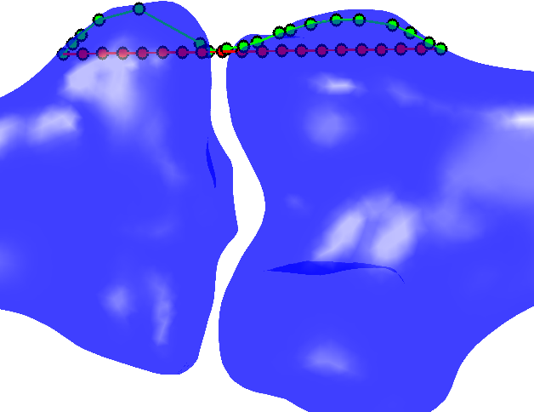
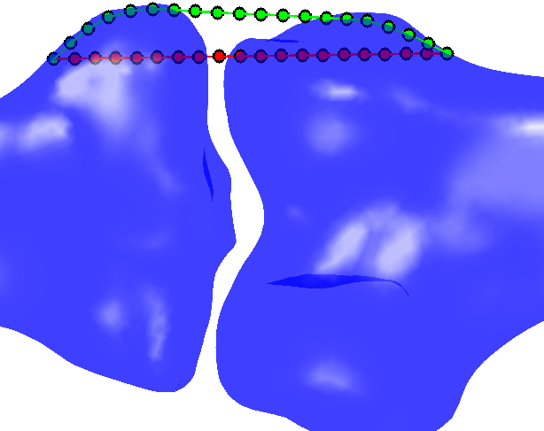
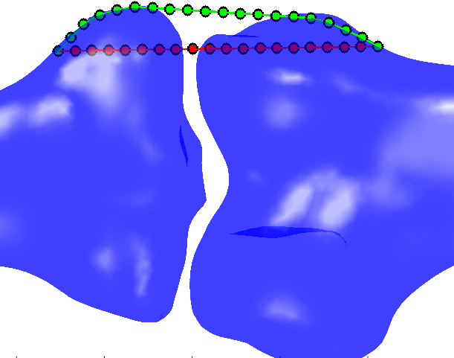
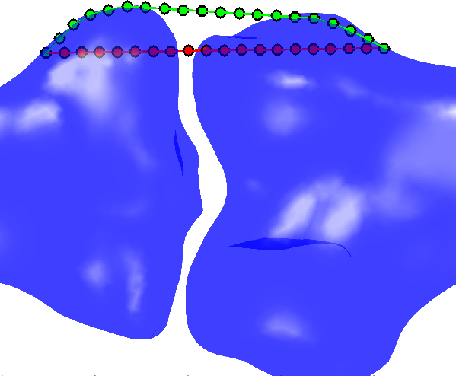
Visual Accuracy Results
Solutions for the same convergence criteria
Method 1
Method 2
Method 3
Method 4

Slide 15
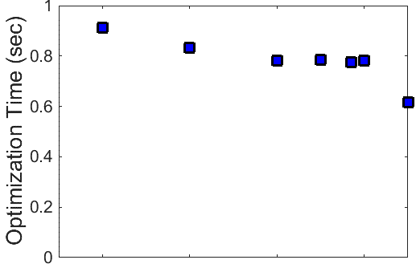
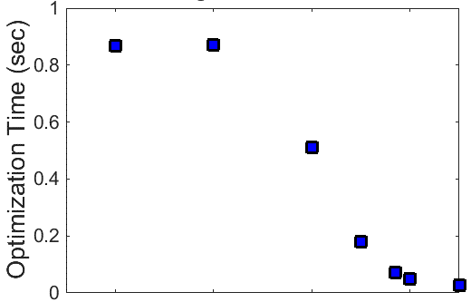
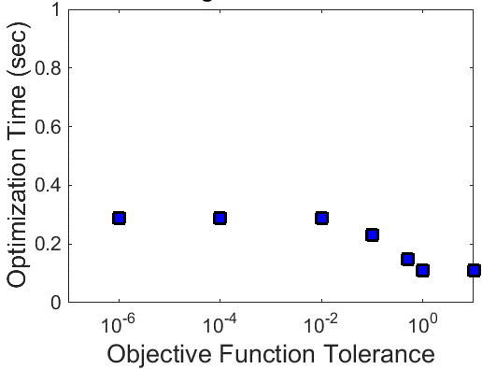
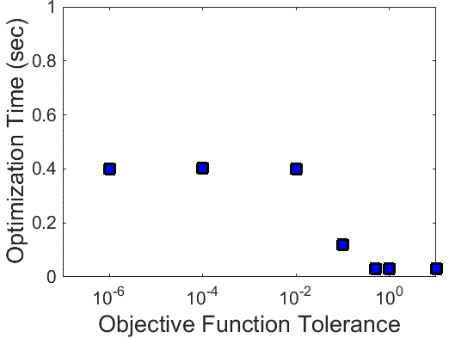
Speed Results
Varied objective function tolerance to reduce convergence time
= tolerance needed for visually acceptable solution
Method 1
Method 2
Method 3
Method 4

Slide 16
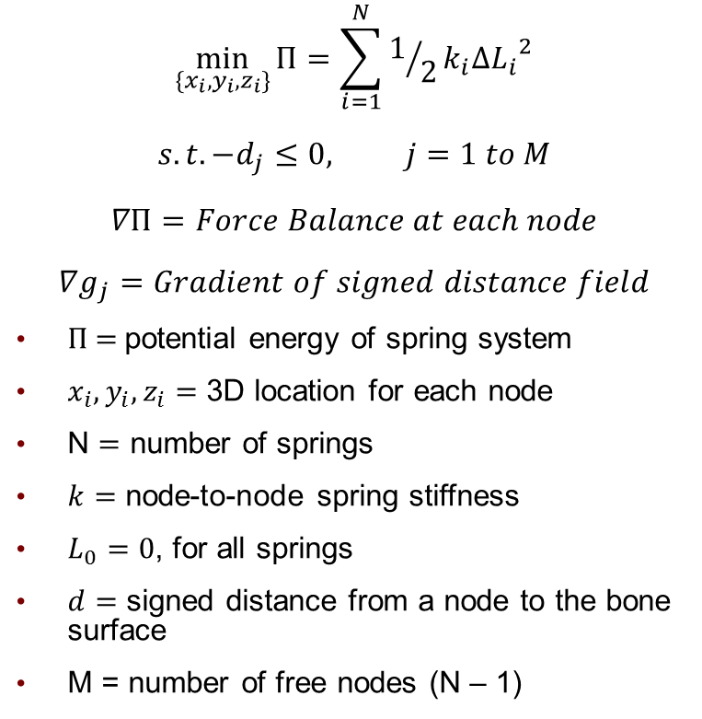
Best Method
fmincon
Femur
$$\min_{\{x_{i},y_{i},z_{i}\}}{Π=\sum_{i=1}^{N}{1/2k_{i}∆{L_{i}}^{2}}}$$
$$s.t. −d_{j}≤0, j=1 to M$$
$$∇Π=Force Balance at each node$$
$$∇g_{j}=Gradient of signed distance field$$
П = potential energy of spring system
$x_{i},y_{i},z_{i}=$ 3D location for each node
N $=$ number of springs
$k=$ node-to-node spring stiffness
$L_{0}=0$, for all springs
$d=$ signed distance from a node to the bone surface
M = number of free nodes (N – 1)
= spring
= free node
= fixed node
d₁
Tibia
d₅

Slide 17
Brief Sensitivity Analysis
Only for method 4 (best method)
Performed sensitivity analysis to understand how to improve convergence speed while maintaining accuracy
Spring stiffness
Number of nodes
Initial guess

Slide 18
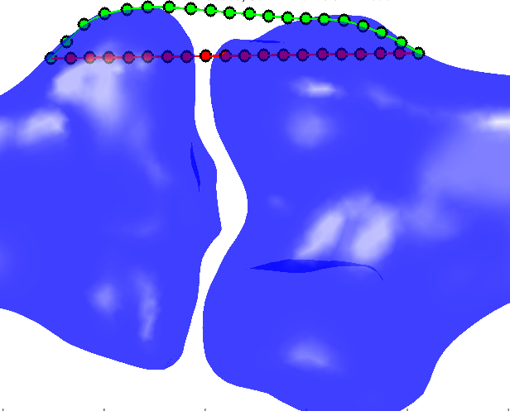
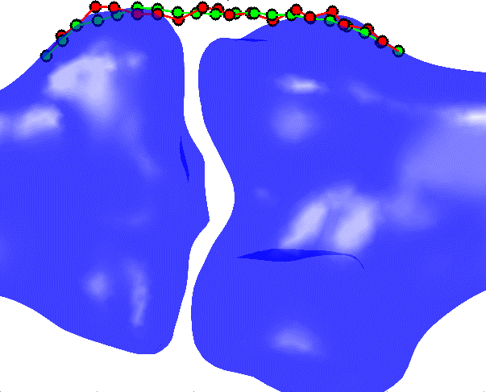
Sensitivity to Initial Guess
Tested two initial guesses
Shows that using the solution at the previous time step of a simulation as the initial guess improves convergence
Convergence Time = 0.12 sec
Convergence Time = 0.051 sec

Slide 19
Conclusions
Utilized optimization techniques discussed in class to implement an efficient ligament wrapping routine
Primary speed-ups:
Implementing analytical solutions for gradients
Good initial guess
Benchmark against wrap objects to assess accuracy and speed
Optimization seems fast enough to implement in simulation framework

Slide 20
Development of Optimal Ligament Wrapping Algorithm
Michael Vignos
ME 748
May 9th, 2016

Slide 21

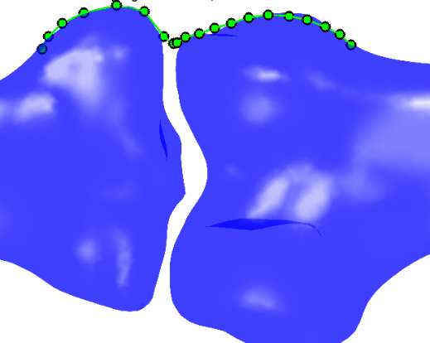
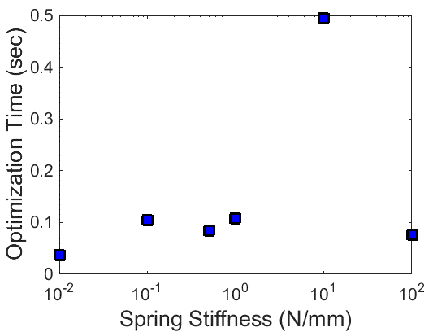
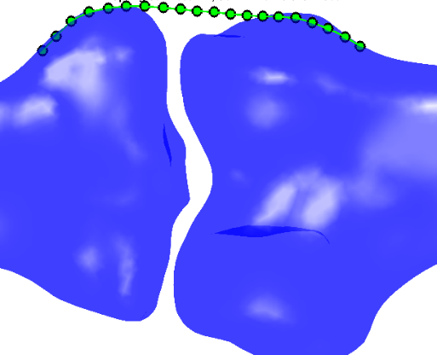
Sensitivity to spring stiffness
Varied stiffness of springs between 0.01 and 100 N/mm
k = 0.01 N/mm
k = 0.1 N/mm
= tolerance needed for visually acceptable solution
k = 0.5 N/mm

Slide 22
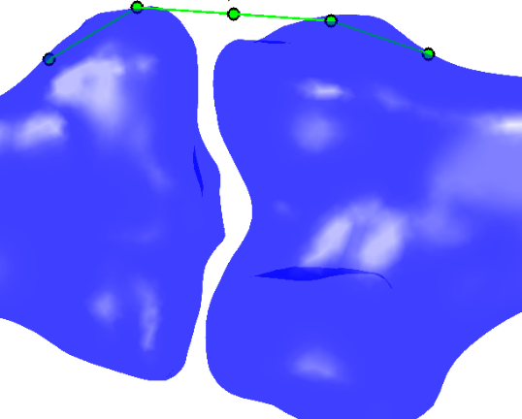
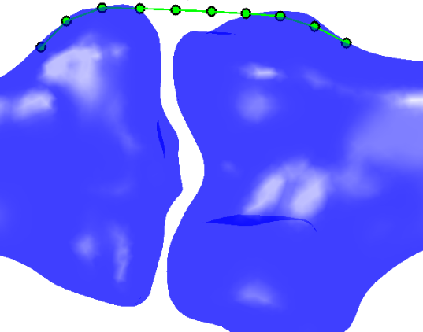
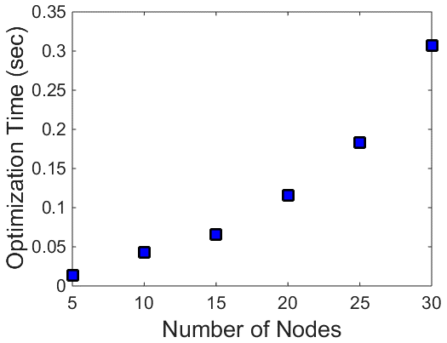
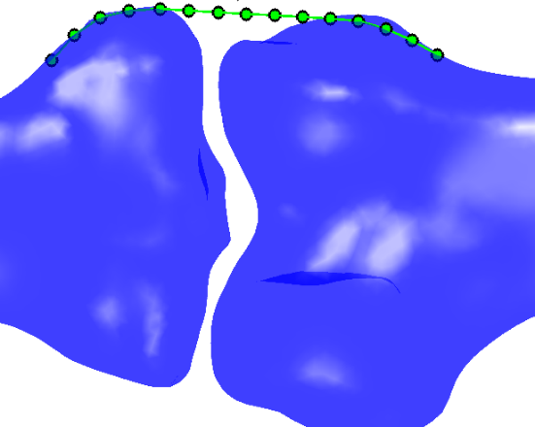
Sensitivity to number of nodes
Varied number of nodes between 5 and 30
5 Nodes
10 Nodes
= tolerance needed for visually acceptable solution
15 Nodes

